Slide 1
UNIT-2(L4 and L5)
While and For loops

Slide 2
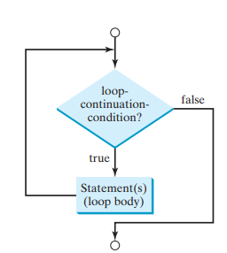

while loop
A while statement is used to execute some block of code repeatedly as long as a condition evaluates to True.
Following are some features of while loop:
In the While loop, the value of the expression is evaluated first.
The body of the loop is entered only when the expression evaluates to true.
After one iteration, the expression is checked again.
This process continues until the expression evaluates to False.
The body of the loop is identified using the indentation with the expression condition as the first statement.

Slide 3
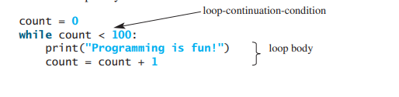
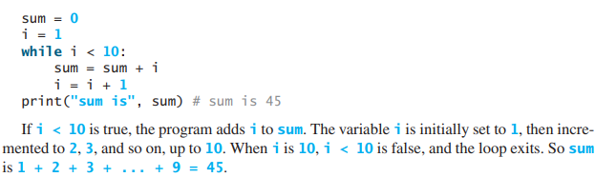
Examples
It will display Programming is fun! 100 times
Make sure that the loop-continuation-condition eventually becomes false so that the loop will terminate. Otherwise infinite loops could be there (i.e., the loop runs forever). If your program takes an unusual long time to run and does not stop, it may have an infinite loop

Slide 4
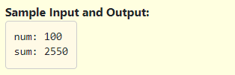
Practice Question 1
Take an integer num as input from the user. Write a code to find sum of all even numbers up to num using while construct, print the result to the console as shown in the example.

Slide 5
Solution
num=int(input("num: "))
sum=0
i=1
while(i<=num):
if(i%2==0):
sum=sum+i
i=i+1
print("sum:",sum)

Slide 6
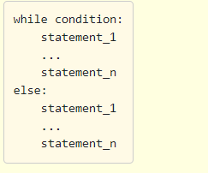
else with while-loop
While loop with else:
We can have an optional else block with while loop as well.
The else part is executed if the condition in the while loop evaluates to False.
The while loop can be terminated with a break statement. In such a case, the else part is ignored.
Hence, a while loop's else part runs if no break occurs and the condition is False.

Slide 7
Examples
i=100
while(i>100):
print("Printing message on true condition")
else:
print("Printing message on false condition")
---------------------------------------------------------------------------------------------------------------------------------------------------
Output:
Printing message on false condition
i=1
while(i<=10): Output:
if(i==2): 1
break
print(i)
i=i+1
else:
print("Printing message on false condition")
break statement is there so, else part will not work

Slide 8
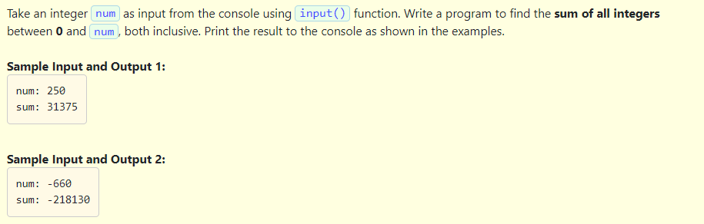
Practice Question 2
Take an integer num as input from the console using input() function. Write a program to find the sum of all integers between 0 and num, both inclusive. Print the result to the console as shown in the examples.

Slide 9
Solution
# Python program to find the sum of integers between 0 and n where n is provided by user
num=int(input("num: "))
i=0
sum=0
while(i<=num):
sum=sum+i
i=i+1
else:
while(num<=0):
sum=sum+num
num=num+1
print("sum:",sum)

Slide 10
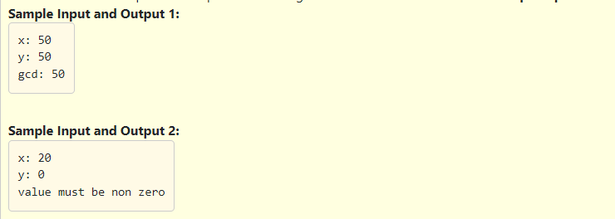
Practice Question 3
The greatest common divisor (also known as greatest common factor, highest common divisor, or highest common factor) of a set of numbers is the largest positive integer number that divides all the numbers in the set without remainder. It is the biggest multiple of all numbers in the set.
Take two integers x and y as input from the console using input() function. Write a program to find the GCD of given inputs x and y, print the result to the console as shown in the example.
Constraints:
If one of the inputs is zero print the message to the console as shown in the Sample Input and Output 2.

Slide 11
x = int(input("x: "))
y = int(input("y: "))
if x == 0 or y == 0:
print("value must be non zero")
else:
if x < y:
result=x
else:
result=y
while result:
if x % result == 0 and y % result == 0:
break
result = result - 1
print("gcd:",result)

Slide 12
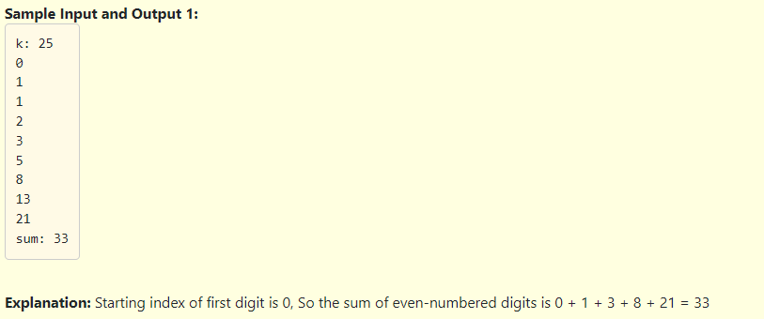
Practice Question 4
Take an integer x as input from the console using input() function. Calculate Fibonacci series one number less than the given input x, and also calculate the sum of all alternate numbers (Even-numbered) in the resultant list. Print the result to the console as shown in the example.

Slide 13
Solution:
x=int(input("k: "))
a=0
b=1
i=0 #index=0
c=0
result=0
while c < x:
print(c)
if(i%2==0): #Even numbered index check
result=result+c
a=b
b=c
c=a+b
i=i+1 #increment in index
print("sum:",result)

Slide 14
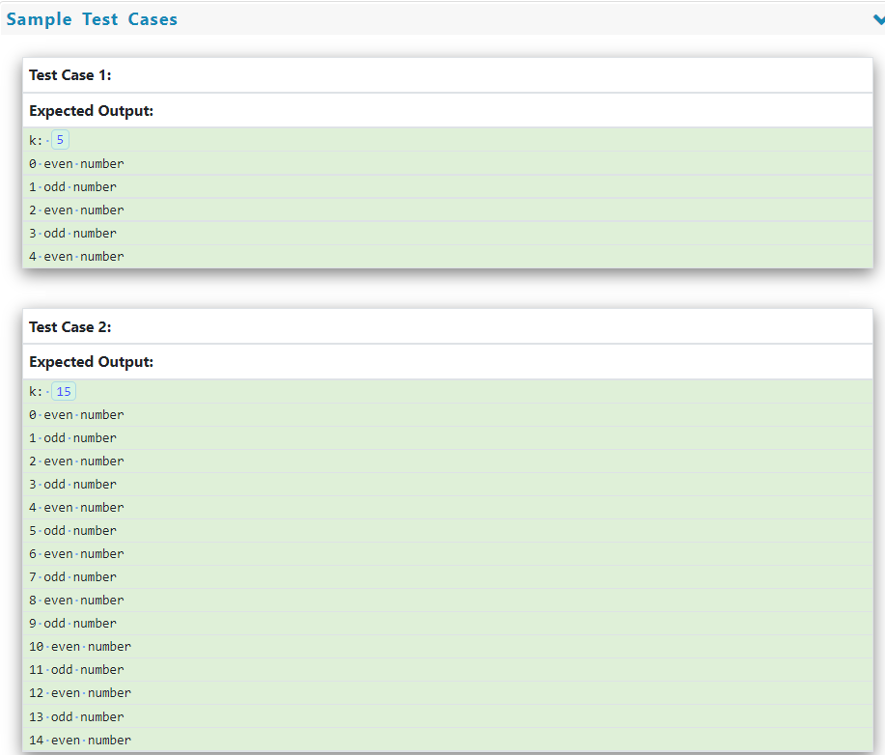
Practice Question 5
Write a program to print all the numbers less than a given number whether they are even or odd using a while loop. Read an integer x as input from the console using input() function. For each number less than x, print the result to the console whether the number is even or odd as shown in sample output below.

Slide 15
Solution
k=int(input("k: "))
i=0
while(i<k):
if i%2==0:
print(i,"even number")
else:
print(i,"odd number")
i=i+1

Slide 16
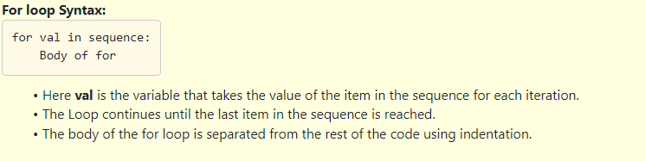
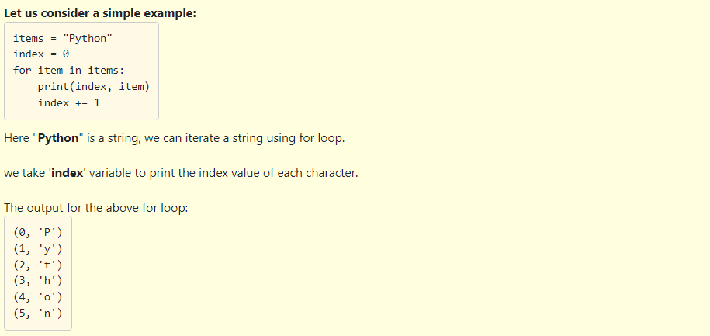
For loop
A for-loop is used to iterate over a range of values using a loop counter, which is a variable taking a range of values in some orderly sequence (e.g., starting at 0 and ending at 10 in increments of 1). The value stored in a loop counter is changed with each iteration of the loop, providing a unique value for each individual iteration. The loop counter is used to decide when to terminate the loop. A for-loop construct can be termed as an entry controlled loop.

Slide 17
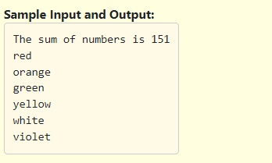
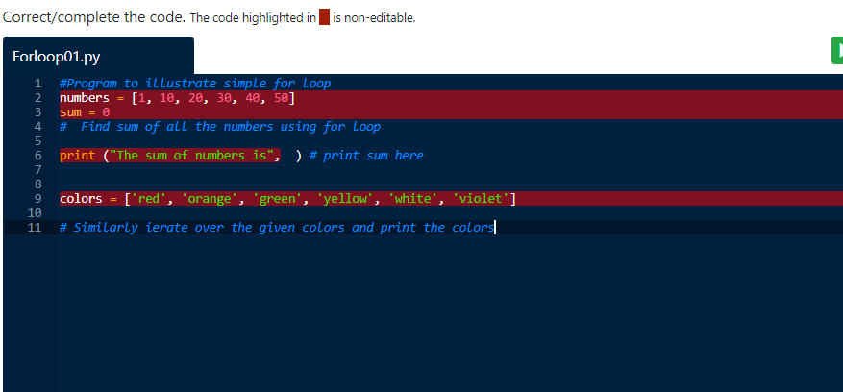
Practice Question 1
Fill the missing code in the below program to understand how to iterate over a for loop . Follow the instructions given in the comment lines while writing the program.

Slide 18
Solution
#Program to illustrate simple for loop
numbers = [1, 10, 20, 30, 40, 50]
sum = 0
# Find sum of all the numbers using for loop
for val in numbers:
sum=sum+val
print ("The sum of numbers is",sum ) # print sum here
colors = ['red', 'orange', 'green', 'yellow', 'white', 'violet']
# Similarly iterate over the given colors and print the colors
for val in colors:
print(val)

Slide 19
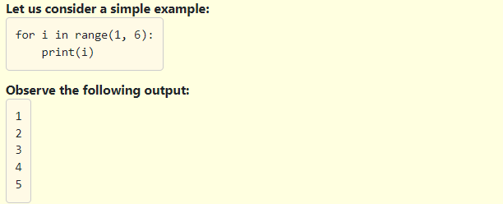
The range() function
We can generate a sequence of numbers using range() function.
We can use the range() function in for loop to iterate through a sequence of numbers.
It can be combined with the len() function to iterate through a sequence using indexing.
Syntax:1. range(stop) :
Returns a sequence of numbers starting from 0 to (stop - 1)
Returns an empty sequence if stop is negative or 0.
range(6) will generate numbers from 0 to 5 (up to 6 not including 6).
Another example:

Slide 20
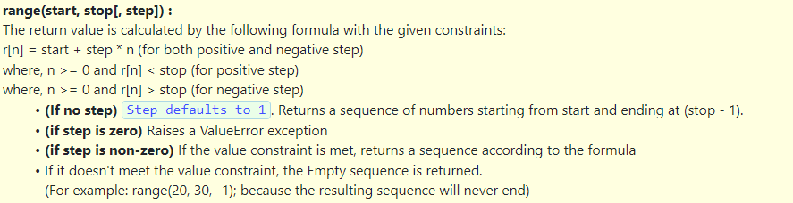
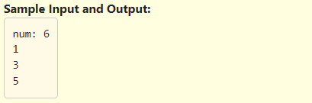
Practice question 2 : use range() function

Slide 21
Solution:
#Program to illustrate simple range function
# take the input num from the user
num=int(input("num: "))
for i in range(1, num + 1, 2):
print(i)

Slide 22
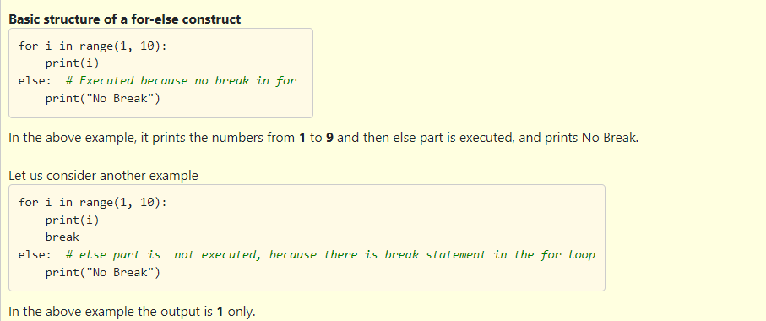
For loop with else
A for loop can have an optional else block as well.
The else part is executed if the items in the sequence used in for-loop exhausts.
A break statement can be used to stop a for-loop. In such case, the else part is ignored.
Hence, a for-loop's else part runs if no break occurs.
A common construct to search for an item is to use a for-loop which can terminate in two scenarios,
If the item is found and a break is encountered, exit out of the for-loop.
If the item is not found, then the loop completes.

Slide 23
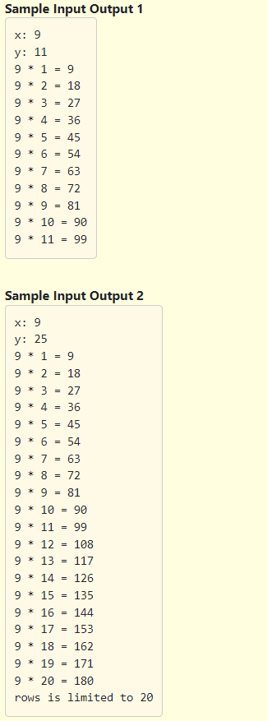
Practice Question 3
Fill in the missing code in the program below to print a multiplication table up to a maximum of 20 rows. Even if the number of rows asked by the user is more than 20, we should limit up to 20 rows and print an error message as shown in the Sample Input Output 2.

Slide 24
Solution
# Multiplication table
x = int(input("x: "))
y = int(input("y: "))
# Fill in the missing code below to print a multiplication table for x upto y rows.
# If y is more than 20, print the relevant message as per instructions and limit the number of rows to 20
if y>20:
for i in range(1, 21):
print(x, "*", i, "=", x * i)
else:
print("rows is limited to 20")
else:
for i in range(1, y + 1):
print(x, "*", i, "=", x * i)

Slide 25
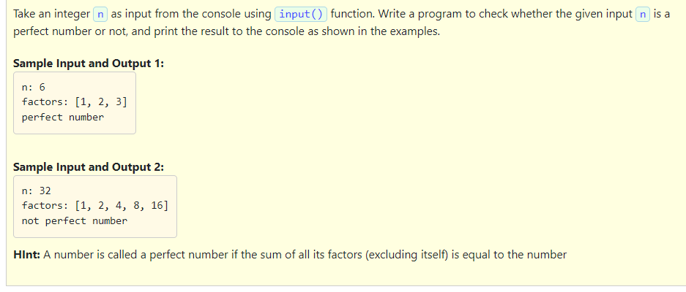
Miscellaneous Practice Questions

Slide 26
Solution
n=int(input("n: "))
l1=list()
sum1 = 0
for i in range(1, n):
if n % i == 0:
l1.append(i)
sum1=sum1+i
print("factors:",l1)
if sum1 == n:
print("perfect number")
else:
print("not perfect number")

Slide 27
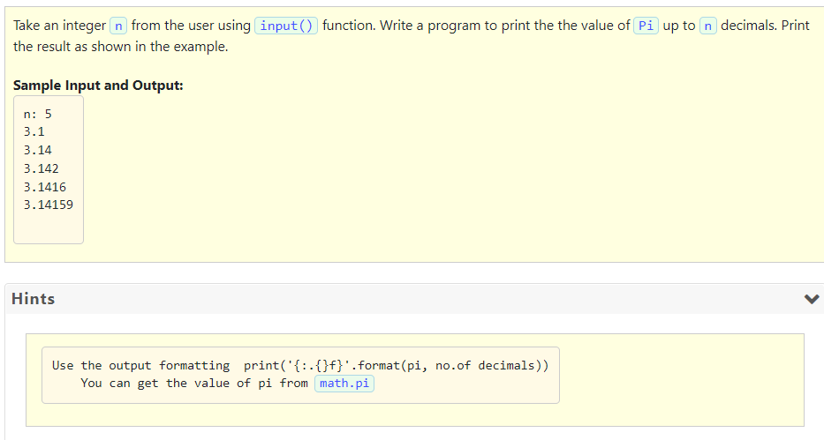
Practice Question

Slide 28
Solution
#Program to print value of pi 1 to 25 decimals
import math
pi = math.pi
# write your code here
n=int(input("n: "))
for i in range(1,n+1):
print('{:.{}f}'.format(pi, i))

Slide 29
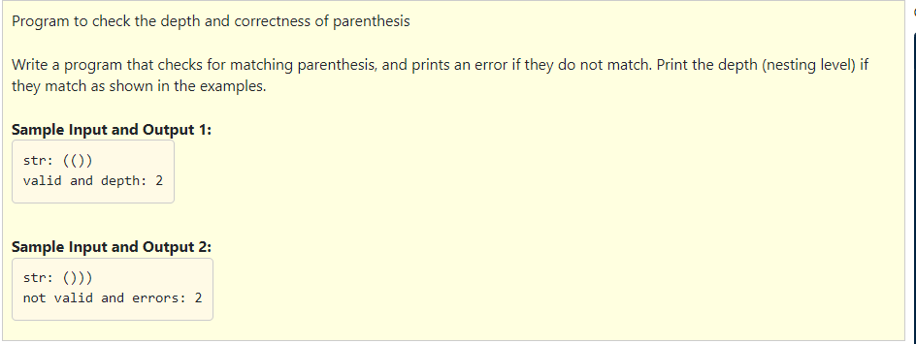
Practice Question

Slide 30
Solution:
str1=input("str: ")
x=0
y=0
length=len(str1)
for i in range(0,length):
if(str1[i]=='('):
x=x+1
elif(str1[i]==')'):
y=y+1
if(x==y):
print("valid and depth:",x)
elif y>x:
print("not valid and errors:",y-x)
else:
print("not valid and errors:",x-y)

Slide 31
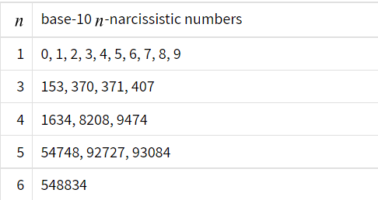
More Questions to do:
WAP to display the sum of digits of a number
WAP to count digits of a number
WAP to display reverse of a number
WAP to check whether the given number is palindrome or not?
WAP to check whether the given number is armstrong or not( or narcissistic number)?
WAP to check whether the given number is prime or composite?
WAP to display factorial of a number
WAP to display n terms of Fibonacci series

Slide 32
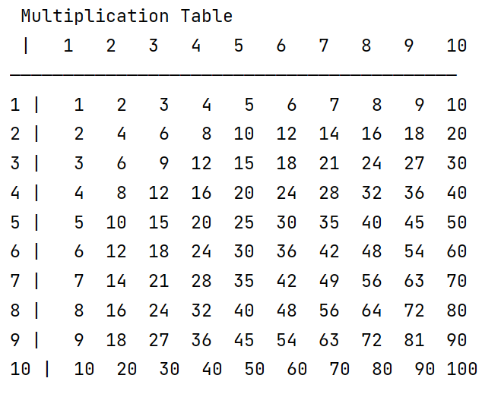
Nested loops
A loop can be nested inside another loop.
Nested loops consist of an outer loop and one or more inner loops. Each time the outer loop is repeated, the inner loops are reentered and started again.
Example:
print(" Multiplication Table")
# Display the number title
print(" |", end='')
for j in range(1, 11):
print(" ", j, end='')
print() # Jump to the new line
print("——————————————————————————————————————————")
# Display table body
for i in range(1, 11):
print(i, "|", end='')
for j in range(1, 11):
print(format(i * j, "4d"), end='')
print() # Jump to the new line

Slide 33
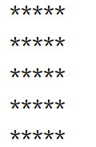
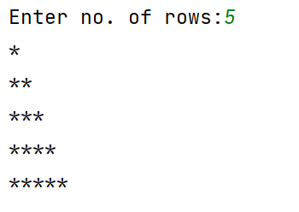
for i in range(1,6):
for j in range(1,6):
print("*",end='')
print()
n=int(input("Enter no. of rows:"))
for i in range(1,n+1):
for j in range(1,i+1):
print("*",end='')
print()

Slide 34
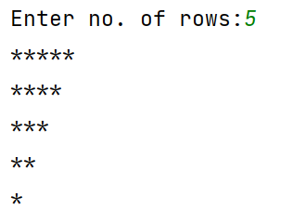
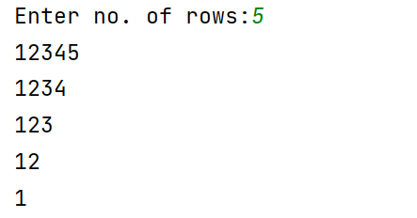
n=int(input("Enter no. of rows:"))
for i in range(n,0,-1):
for j in range(1,i+1):
print("*",end='')
print()
n=int(input("Enter no. of rows:"))
for i in range(n,0,-1):
for j in range(1,i+1):
print(j,end='')
print()

Slide 35
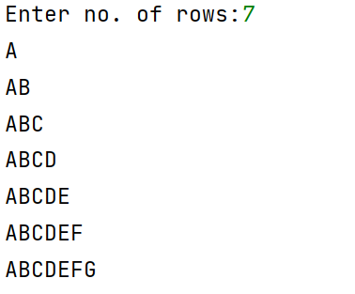
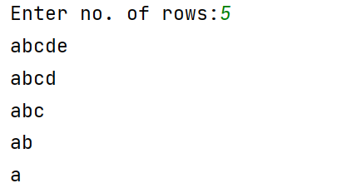
val=65
n=int(input("Enter no. of rows:"))
for i in range(1,n+1):
for j in range(1,i+1):
print(chr(val),end='')
val=val+1
val=65
print()
val=97
n=int(input("Enter no. of rows:"))
for i in range(n,0,-1):
for j in range(1,i+1):
print(chr(val),end='')
val=val+1
val=97
print()

Slide 36
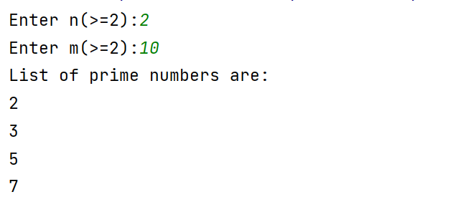
Display all prime number from n to m
flag = 0
n = int(input("Enter n(>=2):"))
m = int(input("Enter m(>=2):"))
print("List of prime numbers are:")
for i in range(n, m + 1):
for j in range(2, (i // 2)+1):
if i % j == 0:
flag = 1
if flag == 0:
print(i)
flag = 0

Slide 37
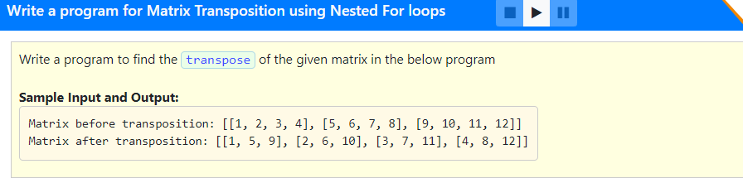

Slide 38
Solution:
matrix = [[1, 2, 3, 4], [5, 6, 7, 8], [9, 10, 11, 12]]
matrix1=[[0,0,0],[0,0,0],[0,0,0],[0,0,0]]
print("matrix:",matrix)
# find the transpose of the matrix and print the result as shown in the example above
for i in range(3):
for j in range(4):
matrix1[j][i]=matrix[i][j]
print("transposed:",matrix1)

Slide 39
More Questions to do:
WAP to display all palindromic numbers from n to m
WAP to display reverse of all even numbers from n to m
WAP to display all perfect numbers from n to m
WAP to display all even list elements from the following list:
list1=[[1,2,3],[4,5,6],[7,8,9]]

